Slide 1

Anticheating Mechanism

Slide 2
Introduction
This internship project focused on developing an anticheating mechanism using emotion detection in images. By analyzing facial expressions, the project aimed to identify potential cheating behavior in online assessments and ensure academic integrity.

Slide 3
Objectives
Understand Emotion Detection: Learn about emotion detection techniques using image processing.
Develop an Emotion Detection Model: Implement a CNN model to detect emotions from facial expressions.
Integrate Anticheating Features: Explore how emotion detection can be applied in an anticheating system.
Address Challenges: Tackle issues such as class imbalance and varying image quality.

Slide 4
Theoretical Background
Facial Expressions: Emotions are expressed through facial cues that can be analyzed.
CNNs for Emotion Recognition: Convolutional Neural Networks are effective for image classification tasks, including emotion detection.

Slide 5
CNN Architecture for Emotion Detection
Input Layer: Image input of facial expressions.
Convolutional Layers: Multiple layers for feature extraction.
Pooling Layers: Reduce dimensionality while retaining important features.
Dropout Layers: Regularization to prevent overfitting.
Dense Output Layer: Classify emotions into categories (e.g., happiness, sadness, anger).

Slide 6
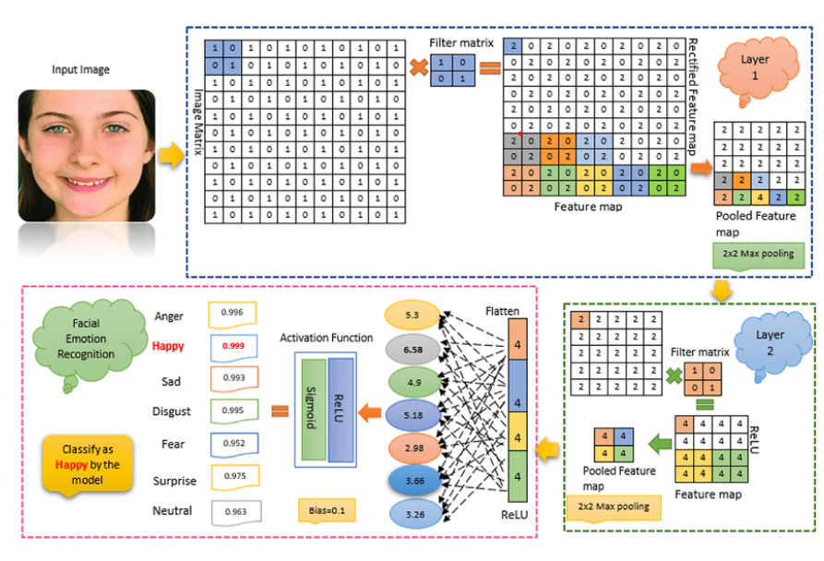

Slide 7
Dataset
Dataset Overview:-
FER2013 Dataset: Contains images of faces with labeled emotions.
https://www.kaggle.com/datasets/msambare/fer2013
Image Samples: Show sample images representing different emotions.

Slide 8
Training the Model
Training Process:
→Data Preparation: Preprocessing images (resizing, normalization).
→Data Augmentation: Apply transformations to enhance the dataset.
→Training Strategies: Use techniques such as batch normalization and early stopping to improve model performance.
Metrics:
→Evaluation Metrics: Accuracy, precision, recall, and F1-score for model m performance.

Slide 9
Integrating Anticheating Mechanism
Application in Anticheating:
Real-Time Emotion Detection: Implement the trained model to analyze student emotions during assessments.
Behavior Analysis: Identify emotions indicative of cheating, such as anxiety or surprise.
Alerts and Feedback: Generate alerts for suspicious behavior for further review.

Slide 10
Challenges and Solutions
Challenges Faced:
Class Imbalance: Some emotions may be underrepresented in the dataset.
Limited Data Quality: Variability in image quality and lighting conditions.
Solutions:
Data Augmentation: Used to create a balanced dataset.
Transfer Learning: Leveraged pre-trained models to improve performance on limited data.

Slide 11
Results and Discussion
Results:
Model Performance: Present accuracy and other evaluation metrics.
Confusion Matrix: Analyze the performance across different emotion classes.
Discussion:
Insights Gained: Discuss the effectiveness of the model and potential areas for improvement.

Slide 12
Conclusions
Effectiveness of Emotion Detection: Demonstrated utility in identifying potential cheating behavior.
Importance of Data Augmentation: Enhanced model robustness and performance.
Future Directions: Highlight the potential for further development and refinement of the anticheating system.

